Slide 1
Guide to Computer Forensics and Investigations
Third Edition
Chapter 10
Recovering Graphics Files

Slide 2
Objectives
Describe types of graphics file formats
Explain types of data compression
Explain how to locate and recover graphics files
Describe how to identify unknown file formats
Explain copyright issues with graphics
Guide to Computer Forensics and Investigations

Slide 3
Recognizing a Graphics File
Contains digital photographs, line art, three-dimensional images, and scanned replicas of printed pictures
  Bitmap images: collection of dots
  Vector graphics: based on mathematical instructions
  Metafile graphics: combination of bitmap and vector
Types of programs
  Graphics editors
  Image viewers
Guide to Computer Forensics and Investigations

Slide 4
Understanding Bitmap and Raster Images
Bitmap images
  Grids of individual pixels
Raster images
  Pixels are stored in rows
  Better for printing
Image quality
  Screen resolution
  Software
  Number of color bits used per pixel
Guide to Computer Forensics and Investigations

Slide 5
Understanding Vector Graphics
Characteristics
  Lines instead of dots
  Store only the calculations for drawing lines and shapes
  Smaller size
  Preserve quality when image is enlarged
CorelDraw, Adobe Illustrator
Guide to Computer Forensics and Investigations

Slide 6
Understanding Metafile Graphics
Combine raster and vector graphics
Example
  Scanned photo (bitmap) with text (vector)
Share advantages and disadvantages of both types
  When enlarged, bitmap part loses quality
Guide to Computer Forensics and Investigations

Slide 7
Understanding Graphics File Formats
Standard bitmap file formats
  Graphic Interchange Format (.gif)
  Joint Photographic Experts Group (.jpeg, .jpg)
  Tagged Image File Format (.tiff, .tif)
  Window Bitmap (.bmp)
Standard vector file formats
  Hewlett Packard Graphics Language (.hpgl)
  Autocad (.dxf)
Guide to Computer Forensics and Investigations

Slide 8
Understanding Graphics File Formats (continued)
Nonstandard graphics file formats
  Targa (.tga)
  Raster Transfer Language (.rtl)
  Adobe Photoshop (.psd) and Illustrator (.ai)
  Freehand (.fh9)
  Scalable Vector Graphics (.svg)
  Paintbrush (.pcx)
Search the Web for software to manipulate unknown image formats
Guide to Computer Forensics and Investigations

Slide 9
Understanding Digital Camera File Formats
Witnesses or suspects can create their own digital photos
Examining the raw file format
  Raw file format
    Referred to as a digital negative
    Typically found on many higher-end digital cameras
  Sensors in the digital camera simply record pixels on the camera’s memory card
  Raw format maintains the best picture quality
Guide to Computer Forensics and Investigations

Slide 10
Understanding Digital Camera File Formats (continued)
Examining the raw file format (continued)
  The biggest disadvantage is that it’s proprietary
    And not all image viewers can display these formats
  The process of converting raw picture data to another format is referred to as demosaicing
Examining the Exchangeable Image File format
  Exchangeable Image File (EXIF) format
    Commonly used to store digital pictures
    Developed by JEIDA as a standard for storing metadata in JPEG and TIFF files
Guide to Computer Forensics and Investigations

Slide 11
Understanding Digital Camera File Formats (continued)
Examining the Exchangeable Image File format (continued)
  EXIF format collects metadata
    Investigators can learn more about the type of digital camera and the environment in which pictures were taken
  EXIF file stores metadata at the beginning of the file
Guide to Computer Forensics and Investigations

Slide 12
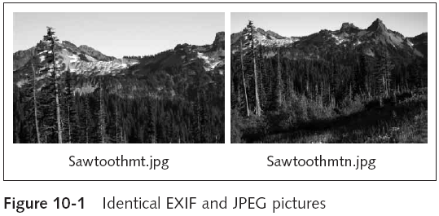
Understanding Digital Camera File Formats (continued)
Guide to Computer Forensics and Investigations

Slide 13
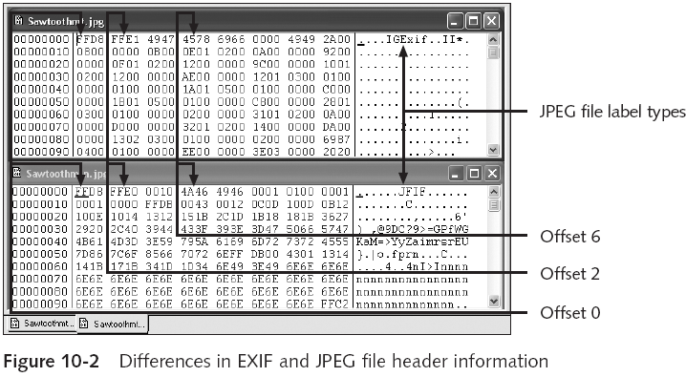
Understanding Digital Camera File Formats (continued)
Guide to Computer Forensics and Investigations

Slide 14
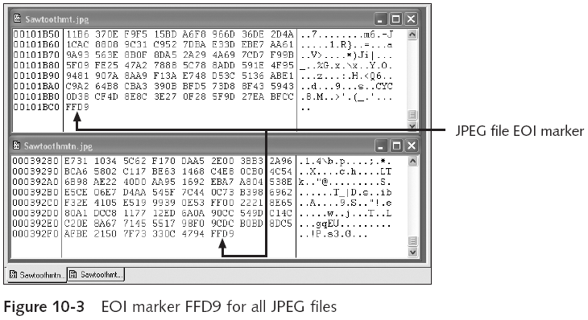
Understanding Digital Camera File Formats (continued)
Guide to Computer Forensics and Investigations

Slide 15
Understanding Digital Camera File Formats (continued)
Examining the Exchangeable Image File format (continued)
  With tools such as ProDiscover and Exif Reader
    You can extract metadata as evidence for your case
Guide to Computer Forensics and Investigations

Slide 16
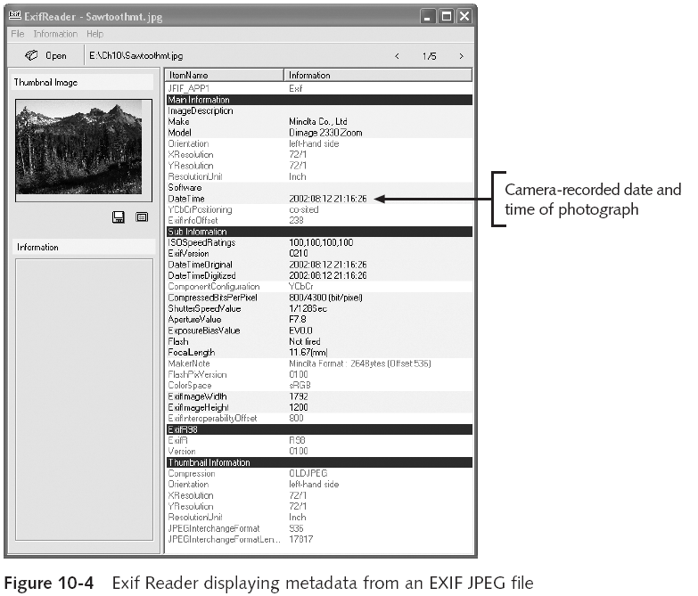
Guide to Computer Forensics and Investigations

Slide 17
Understanding Data Compression
Some image formats compress their data
  GIF, JPEG, PNG
Others, like BMP, do not compress their data
  Use data compression tools for those formats
Data compression
  Coding of data from a larger to a smaller form
  Types
    Lossless compression and lossy compression
Guide to Computer Forensics and Investigations

Slide 18
Lossless and Lossy Compression
Lossless compression
  Reduces file size without removing data
  Based on Huffman or Lempel-Ziv-Welch coding
    For redundant bits of data
  Utilities: WinZip, PKZip, StuffIt, and FreeZip
Lossy compression
  Permanently discards bits of information
  Vector quantization (VQ)
    Determines what data to discard based on vectors in the graphics file
  Utility: Lzip
Guide to Computer Forensics and Investigations

Slide 19
Locating and Recovering Graphics Files
Operating system tools
  Time consuming
  Results are difficult to verify
Computer forensics tools
  Image headers
    Compare them with good header samples
    Use header information to create a baseline analysis
  Reconstruct fragmented image files
    Identify data patterns and modified headers
Guide to Computer Forensics and Investigations

Slide 20
Identifying Graphics File Fragments
Carving or salvaging
  Recovering all file fragments
Computer forensics tools
  Carve from slack and free space
  Help identify image files fragments and put them together
Guide to Computer Forensics and Investigations

Slide 21
Repairing Damage Headers
Use good header samples
Each image file has a unique file header
  JPEG: FF D8 FF E0 00 10
  Most JPEG files also include JFIF string
Exercise:
  Investigate a possible intellectual property theft by a contract employee of Exotic Mountain Tour Service (EMTS)
Guide to Computer Forensics and Investigations

Slide 22
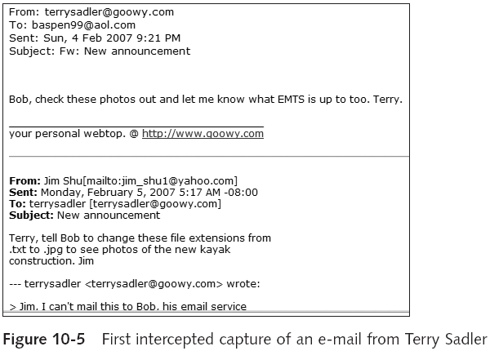
Searching for and Carving Data from Unallocated Space
Guide to Computer Forensics and Investigations

Slide 23
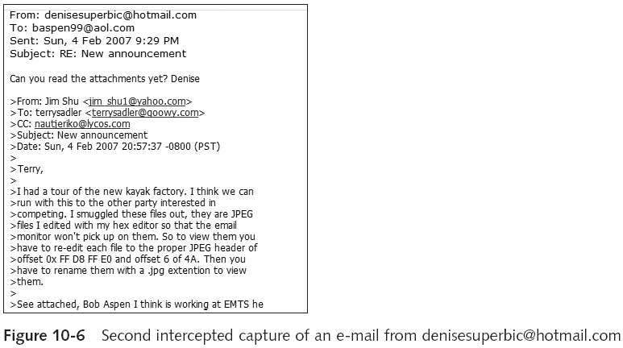
Searching for and Carving Data from Unallocated Space (continued)
Guide to Computer Forensics and Investigations

Slide 24
Searching for and Carving Data from Unallocated Space (continued)
Steps
  Planning your examination
  Searching for and recovering digital photograph evidence
    Use ProDiscover to search for and extract (recover) possible evidence of JPEG files
    False hits are referred to as false positives
Guide to Computer Forensics and Investigations

Slide 25
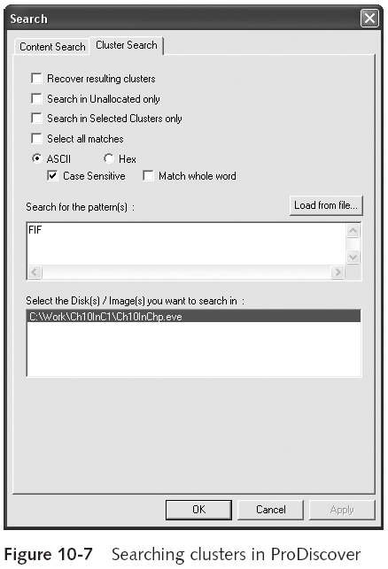
Guide to Computer Forensics and Investigations

Slide 26
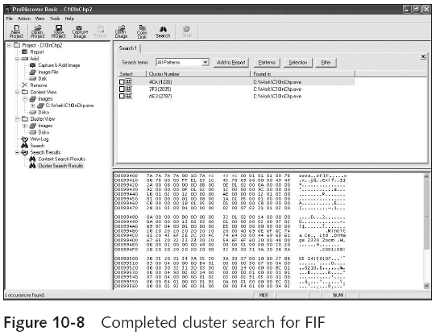
Searching for and Carving Data from Unallocated Space (continued)
Guide to Computer Forensics and Investigations

Slide 27
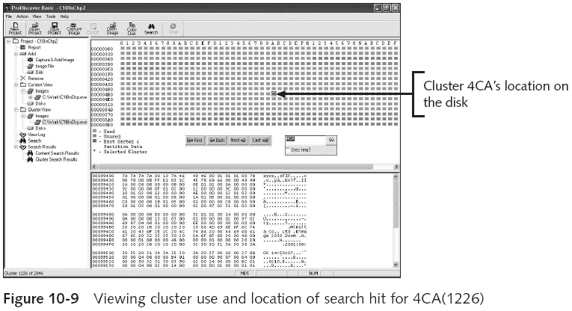
Searching for and Carving Data from Unallocated Space (continued)
Guide to Computer Forensics and Investigations

Slide 28
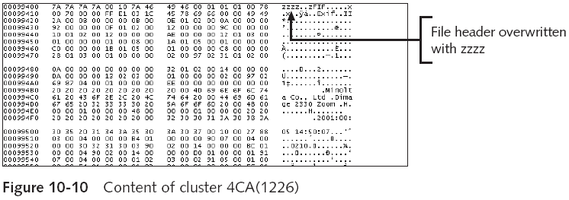
Searching for and Carving Data from Unallocated Space (continued)
Guide to Computer Forensics and Investigations

Slide 29
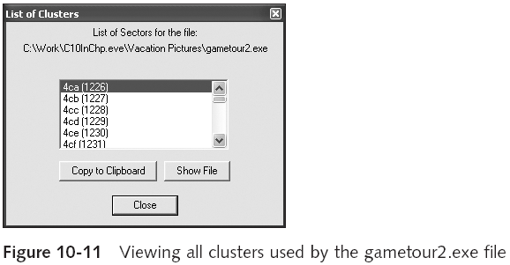
Searching for and Carving Data from Unallocated Space (continued)
Guide to Computer Forensics and Investigations

Slide 30
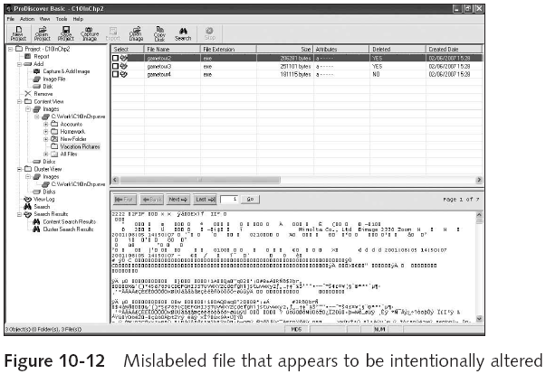
Searching for and Carving Data from Unallocated Space (continued)
Guide to Computer Forensics and Investigations

Slide 31
Rebuilding File Headers
Try to open the file first and follow steps if you can’t see its content
Steps
  Recover more pieces of file if needed
  Examine file header
    Compare with a good header sample
    Manually insert correct hexadecimal values
  Test corrected file
Guide to Computer Forensics and Investigations

Slide 32
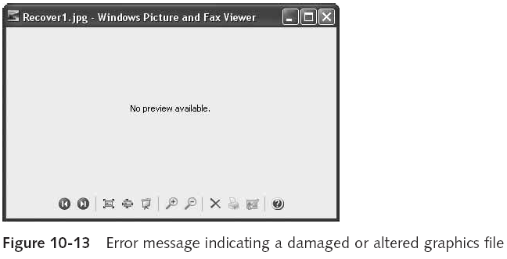
Rebuilding File Headers (continued)
Guide to Computer Forensics and Investigations

Slide 33
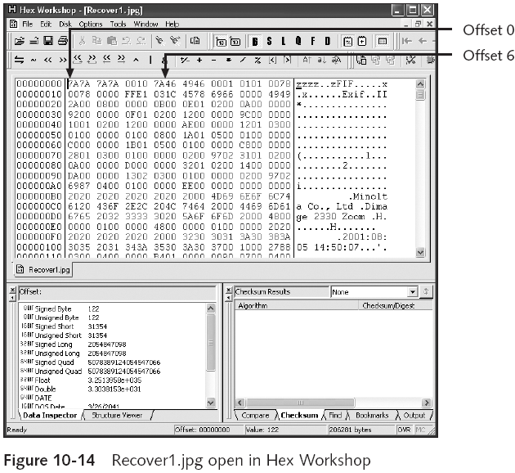
Guide to Computer Forensics and Investigations

Slide 34
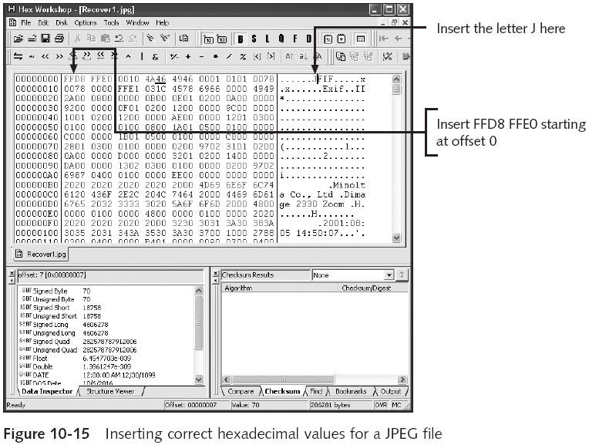
Guide to Computer Forensics and Investigations

Slide 35
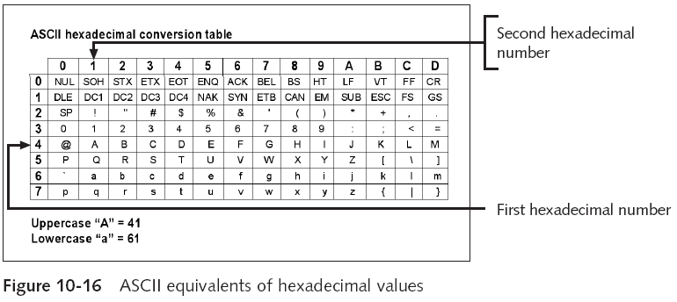
Rebuilding File Headers (continued)
Guide to Computer Forensics and Investigations

Slide 36
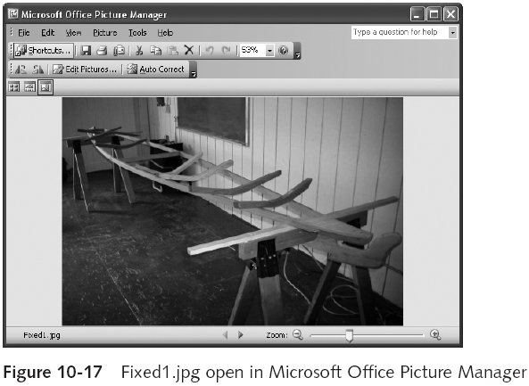
Rebuilding File Headers (continued)
Guide to Computer Forensics and Investigations

Slide 37
Reconstructing File Fragments
Locate the starting and ending clusters
  For each fragmented group of clusters in the file
Steps
  Locate and export all clusters of the fragmented file
  Determine the starting and ending cluster numbers for each fragmented group of clusters
  Copy each fragmented group of clusters in their proper sequence to a recovery file
  Rebuild the corrupted file’s header to make it readable in a graphics viewer
Guide to Computer Forensics and Investigations

Slide 38
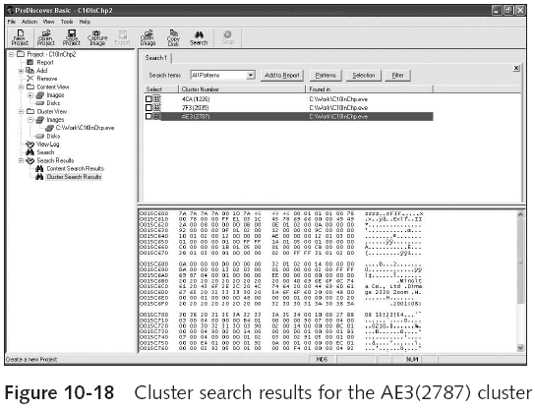
Reconstructing File Fragments (continued)
Guide to Computer Forensics and Investigations

Slide 39
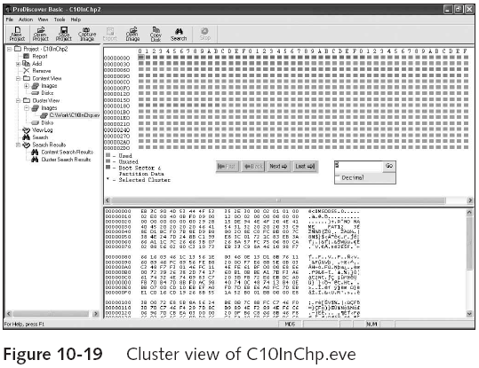
Reconstructing File Fragments (continued)
Guide to Computer Forensics and Investigations

Slide 40
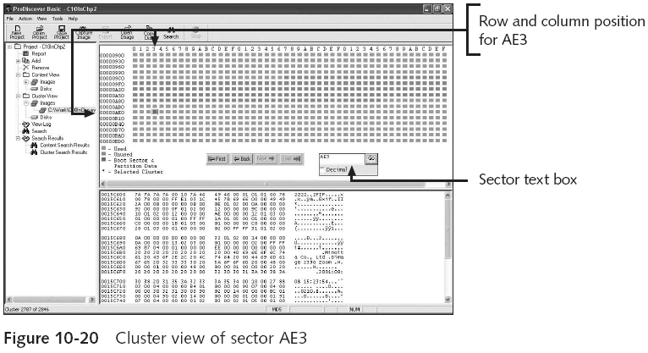
Reconstructing File Fragments (continued)
Guide to Computer Forensics and Investigations

Slide 41
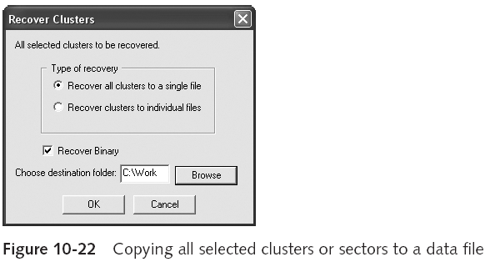
Reconstructing File Fragments (continued)
Guide to Computer Forensics and Investigations

Slide 42
Reconstructing File Fragments (continued)
Remember to save the updated recovered data with a .jpg extension
Sometimes suspects intentionally corrupt cluster links in a disk’s FAT
  Bad clusters appear with a zero value on a disk editor
Guide to Computer Forensics and Investigations

Slide 43
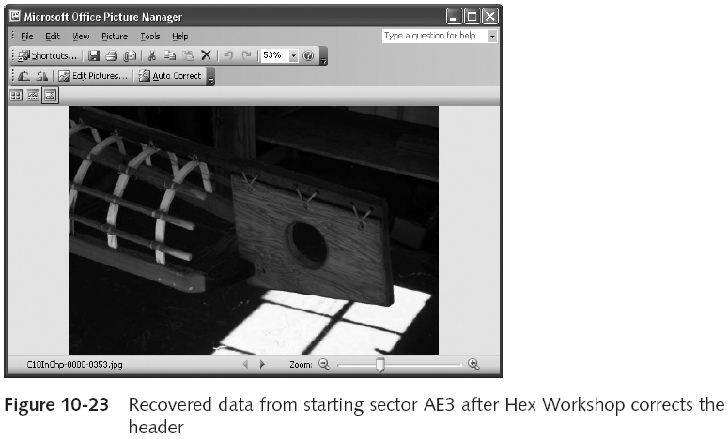
Reconstructing File Fragments (continued)
Guide to Computer Forensics and Investigations

Slide 44
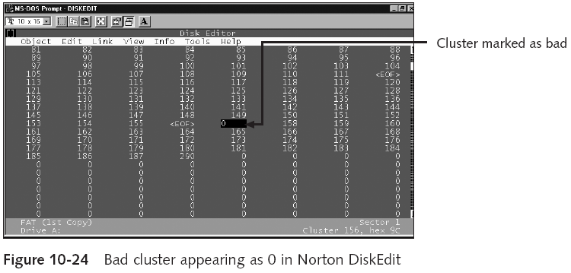
Reconstructing File Fragments (continued)
Guide to Computer Forensics and Investigations

Slide 45
Identifying Unknown File Formats
The Internet is the best source
  Search engines like Google
  Find explanations and viewers
Popular Web sites
  www.digitek-asi.com/file_formats.html
  www.wotsit.org
  http://whatis.techtarget.com
Guide to Computer Forensics and Investigations

Slide 46
Analyzing Graphics File Headers
Necessary when you find files your tools do not recognize
Use hex editor such as Hex Workshop
  Record hexadecimal values on header
Use good header samples
Guide to Computer Forensics and Investigations

Slide 47
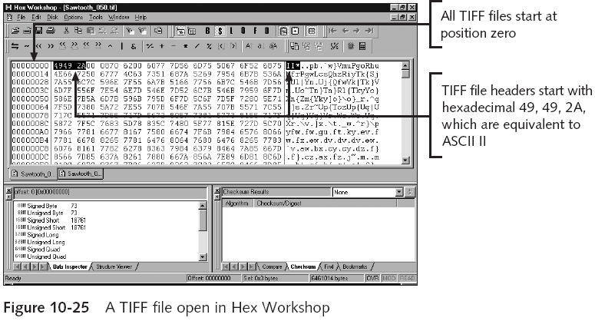
Analyzing Graphics File Headers (continued)
Guide to Computer Forensics and Investigations

Slide 48
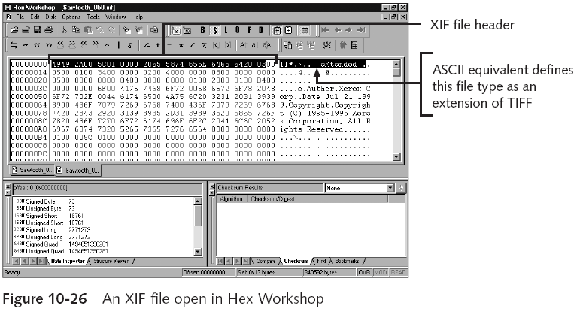
Analyzing Graphics File Headers (continued)
Guide to Computer Forensics and Investigations

Slide 49
Tools for Viewing Images
Use several viewers
  ThumbsPlus
  ACDSee
  QuickView
  IrfanView
GUI forensics tools include image viewers
  ProDiscover
  EnCase
  FTK
  X-Ways Forensics
  iLook
Guide to Computer Forensics and Investigations

Slide 50
Understanding Steganography in Graphics Files
Steganography hides information inside image files
  Ancient technique
  Can hide only certain amount of information
Insertion
  Hidden data is not displayed when viewing host file in its associated program
    You need to analyze the data structure carefully
  Example: Web page
Guide to Computer Forensics and Investigations

Slide 51
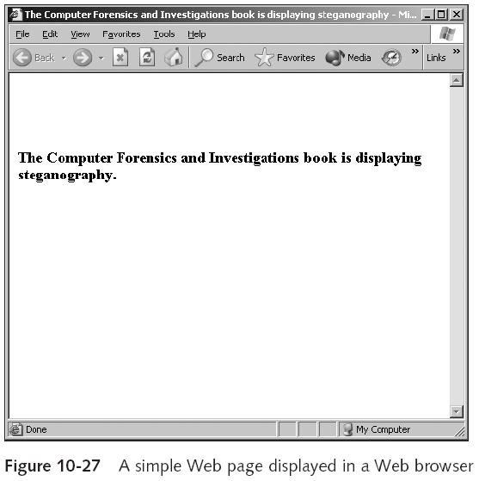
Guide to Computer Forensics and Investigations

Slide 52
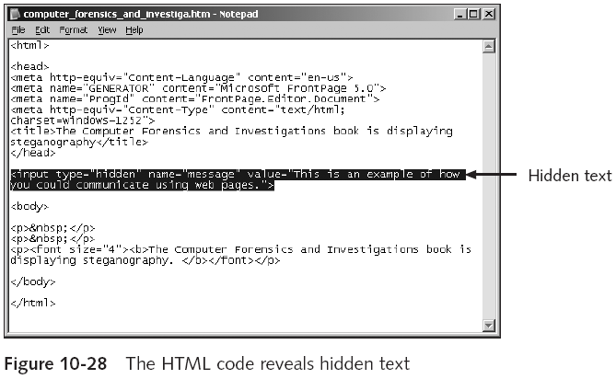
Understanding Steganography in Graphics Files (continued)
Guide to Computer Forensics and Investigations

Slide 53
Understanding Steganography in Graphics Files (continued)
Substitution
  Replaces bits of the host file with bits of data
  Usually change the last two LSBs
  Detected with steganalysis tools
Usually used with image files
  Audio and video options
Hard to detect
Guide to Computer Forensics and Investigations

Slide 54
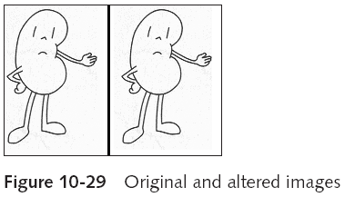
Understanding Steganography in Graphics Files (continued)
Guide to Computer Forensics and Investigations

Slide 55
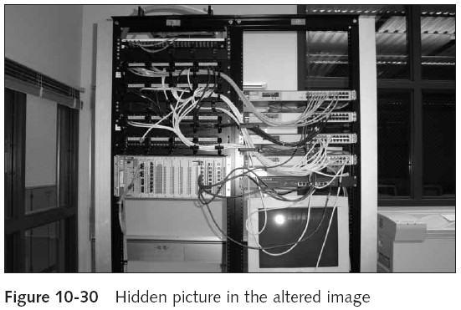
Understanding Steganography in Graphics Files (continued)
Guide to Computer Forensics and Investigations

Slide 56
Using Steganalysis Tools
Detect variations of the graphic image
  When applied correctly you cannot detect hidden data in most cases
Methods
  Compare suspect file to good or bad image versions
  Mathematical calculations verify size and palette color
  Compare hash values
Guide to Computer Forensics and Investigations

Slide 57
Identifying Copyright Issues with Graphics
Steganography originally incorporated watermarks
Copyright laws for Internet are not clear
  There is no international copyright law
Check www.copyright.gov
Guide to Computer Forensics and Investigations

Slide 58
Summary
Image types
  Bitmap
  Vector
  Metafile
Image quality depends on various factors
Image formats
  Standard
  Nonstandard
Digital camera photos are typically in raw and EXIF JPEG formats
Guide to Computer Forensics and Investigations

Slide 59
Summary (continued)
Some image formats compress their data
  Lossless compression
  Lossy compression
Recovering image files
  Carving file fragments
  Rebuilding image headers
Software
  Image editors
  Image viewers
Guide to Computer Forensics and Investigations

Slide 60
Summary (continued)
Steganography
  Hides information inside image files
  Forms
    Insertion
    Substitution
Steganalysis
  Finds whether image files hide information
Guide to Computer Forensics and Investigations

